Slide 1
POST HOC TEST IN ANOVA
BIO STATISTICS
PHARMACY

Slide 2
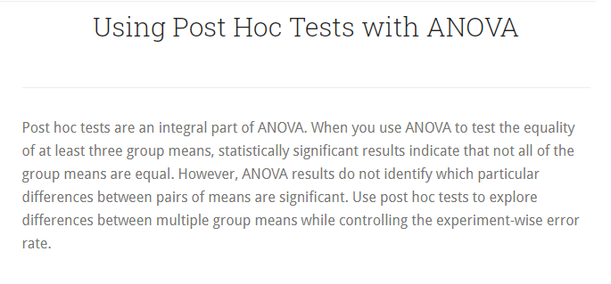

Slide 3
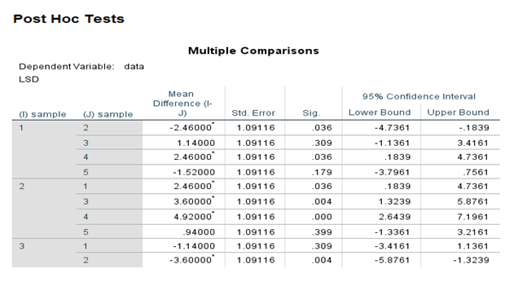
LSD TEST
LEAST SIGNIFICANT TEST
LSD stands for Least Significant Difference t test is used to find the significant difference between all pair of means.
Those pairs of means are significantly different whose p-value is less than α

Slide 4
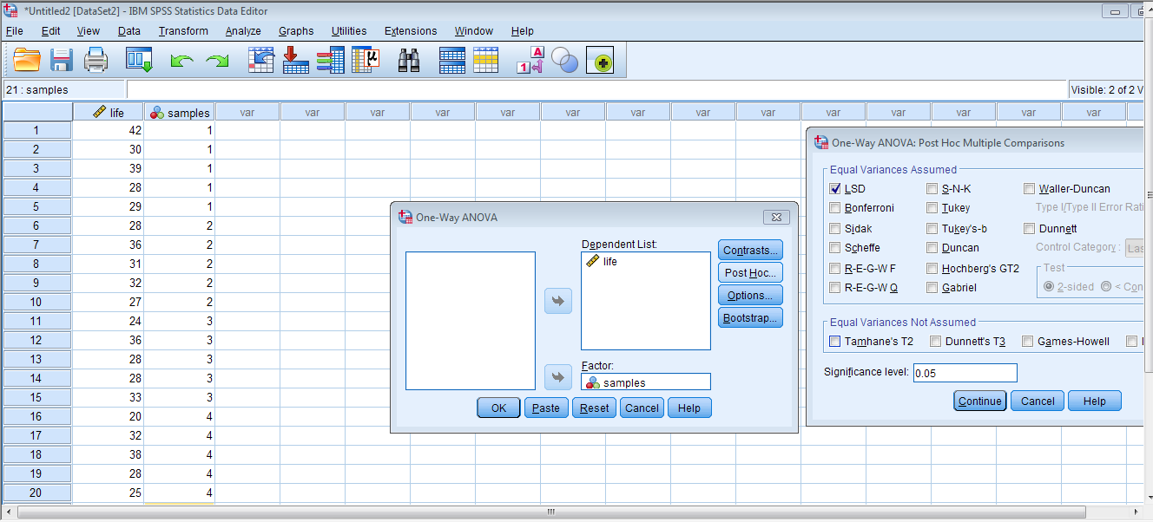
How to perform in SPSS
Click on LSD test option
First click “post Hoc” option seen below

